Slide 1
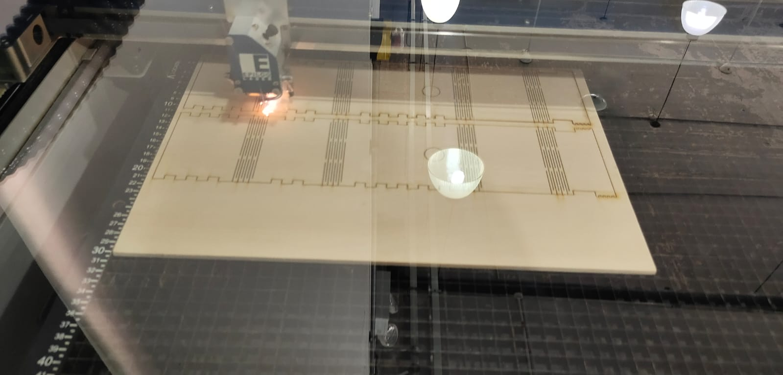
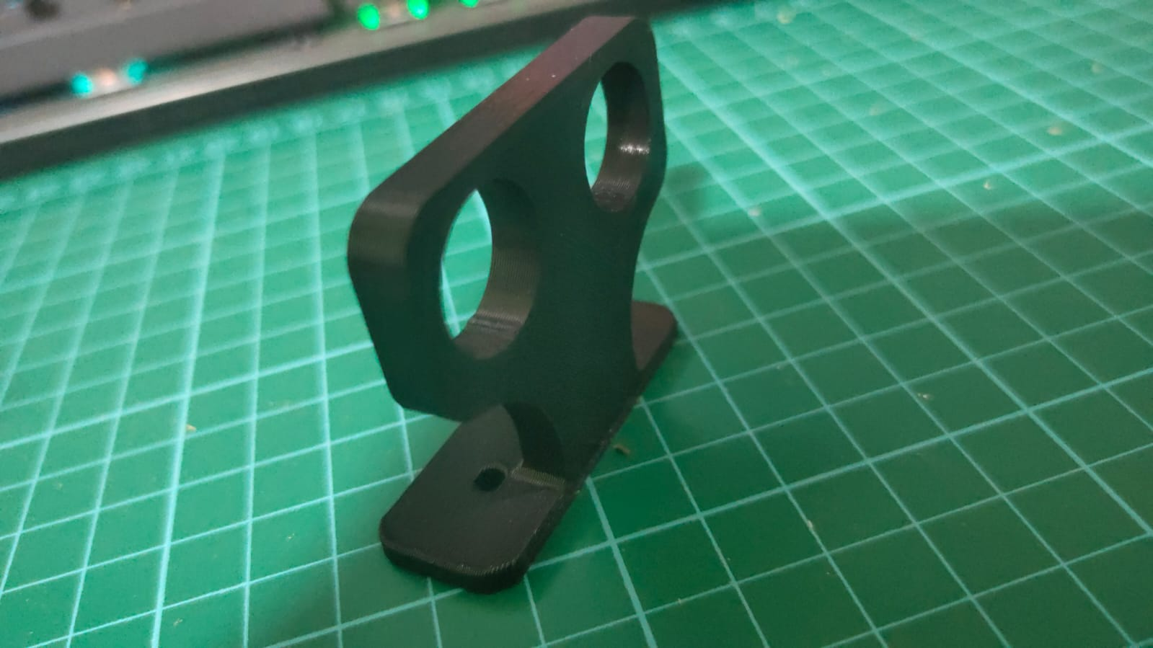
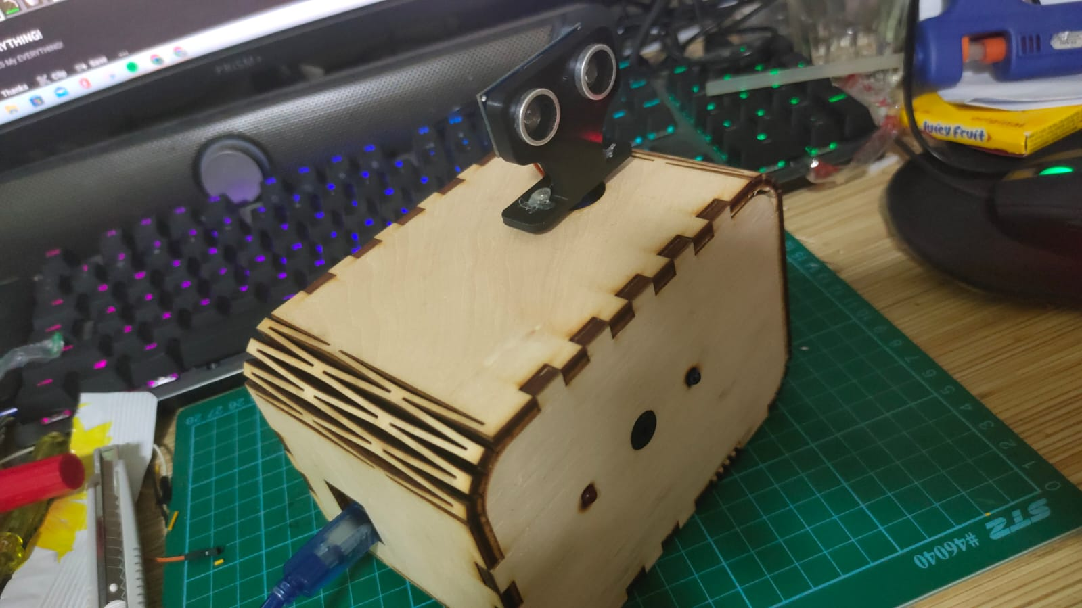
Radar system using Ultrasonic sensor for detection
buzzer
led light
Lasor cutting
3d printed sensor holder

